Slide 1



International school of
programming for kids
Module 2. Lesson 5.
Memory Card Application P. 3
MG
Notes:
Ссылка на методичку >> Link to methodological plan

Slide 2

Module 2. Lesson 5. Memory Card Application. P.3
Discussion:
Memory Card Application

Slide 3
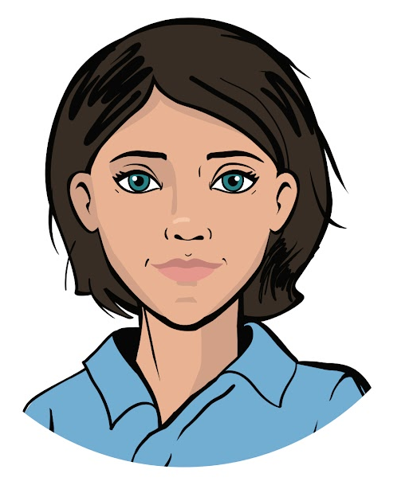

Continuing to work on our project
We are continuing to work on our project for the “Citizen of the World” cultural center.
The Center has ordered a Memory Card application to sharpen their specialists’ knowledge of world cultures and languages.
We have already programmed the basic interface for this application and learned to ask one question with several answer options.
Ready to keep working?
Discussing Project Tasks
Emily,
Project Manager

Slide 4
Let’s look at a mind map of the project
Widget creation
Positioning in layouts
Global layout display
Widget creation
Positioning in layouts
Global layout display
Question form display
Answer form display
Memory Card
Some of the project goals have already been met
Question storage
Event handling
Question and answer structure
Storing all questions
Question display
Handling "Answer" button click
Handling radio button click

Slide 5
Let’s look at a mind map of the project
Widget creation
Positioning in layouts
Global layout display
Widget creation
Positioning in layouts
Global layout display
Question form display
Answer form display
Memory Card
Question storage
Event handling
Goals for today
Question and answer structure
Storing all questions
Question display
Handling "Answer" button click
Handling radio button click

Slide 6
The goal for the work day
is to program the storage of a set of questions and the move from one question to another.
Today you will:
Discussing Project Tasks
review what a class is and program your own class
choose a data structure for storing the questions
implement a system of questions and answers in your program!

Slide 7

Module 2. Lesson 5. Memory Card Application. P.3
Qualification

Slide 8
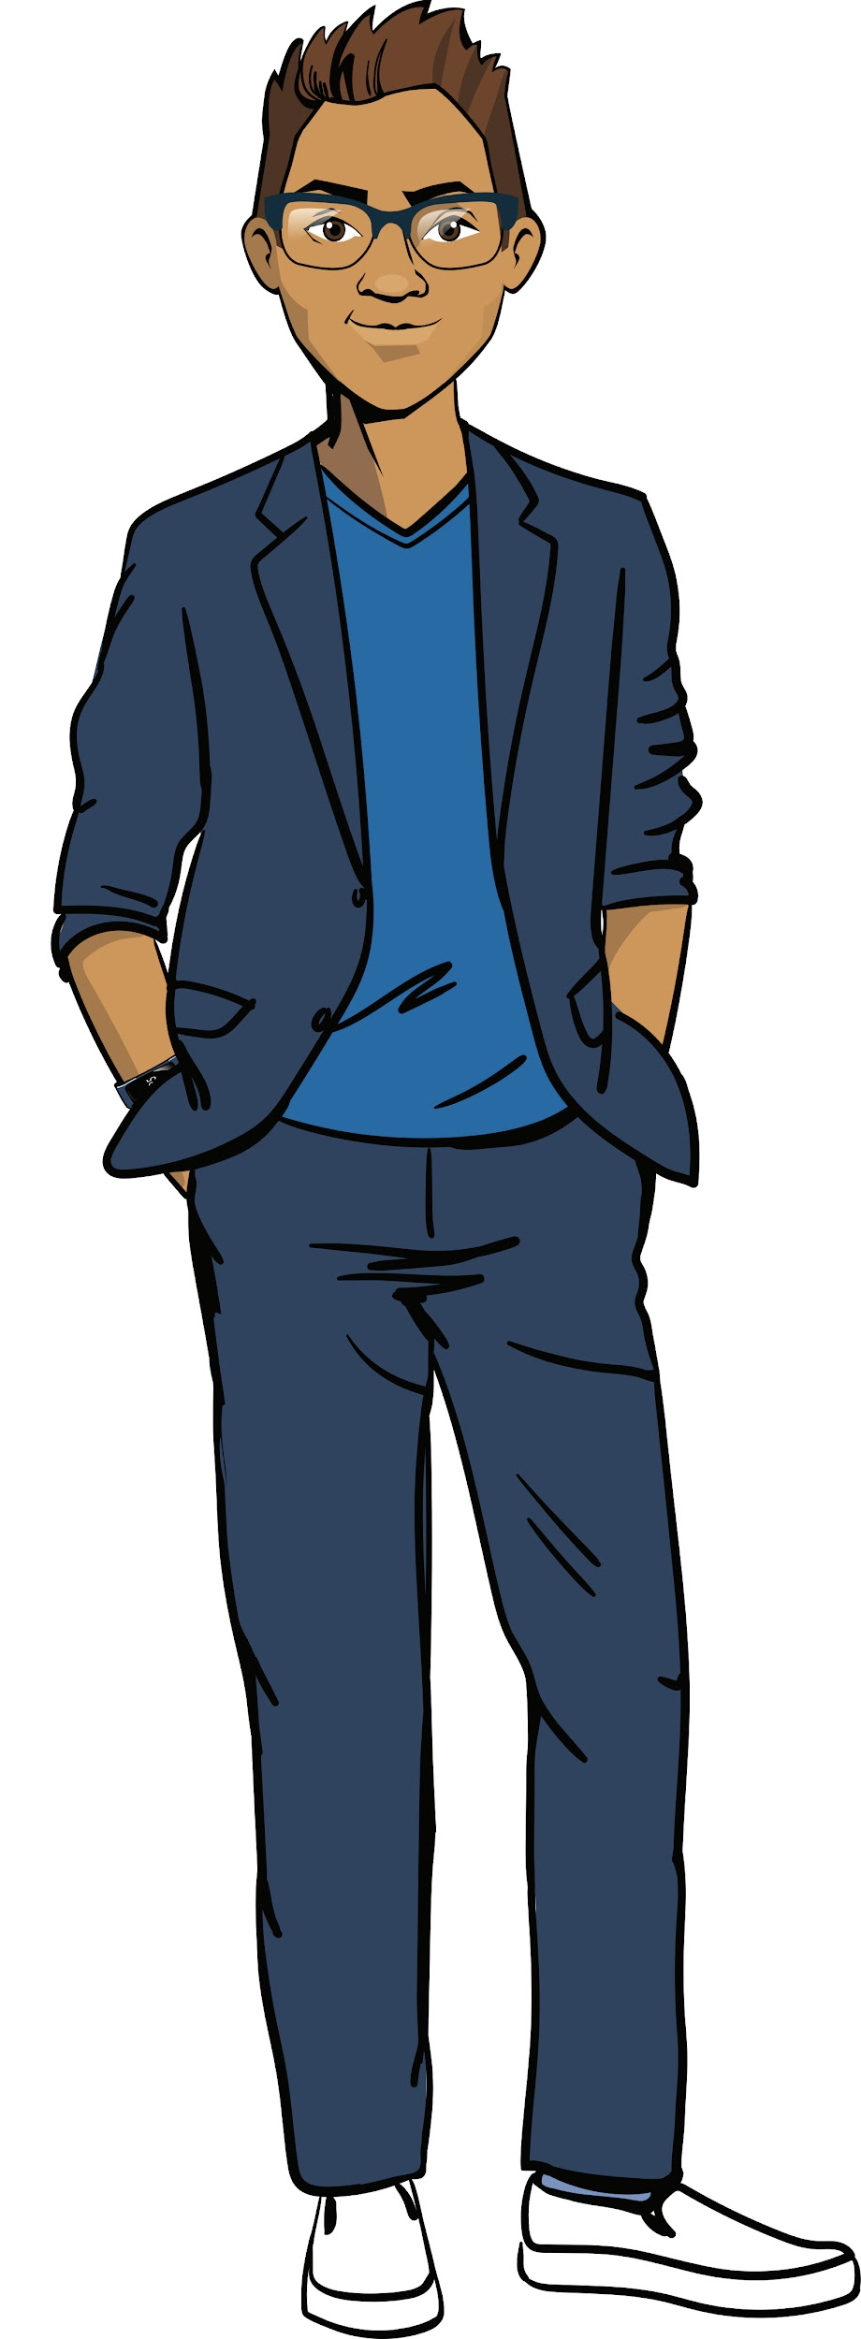
Show your knowledge
of data structures and object-oriented programming
Qualification

Slide 9
What is a list?
What methods for working with lists do you know?
Qualification

Slide 10
A list is a structure for the ordered storage of various types of data.
results = list()
results = [181, 176, 160, 178, 171, 179, 165]
181 | 176 | 160 | 178 | 171 | 179 | 165
0 | 1 | 2 | 3 | 4 | 5 | 6
Qualification
print(‘Best result:’, results[0])
Best result: 181
Get an element from the list using its number (index)
The program will print

Slide 11
A list is a structure for the ordered storage of various types of data.
Let’s say we have a list:
students = [‘Smith’, ‘Garcia’, ‘Patel’]
Add the last name ‘Tanner’ to the list
students.append(‘Tanner’)
Qualification
Remove the last name ‘Smith’ from the list
students.remove(‘Smith’)
Check if the list contains the last name ‘Hanz’
‘Hanz’ in students
Sort the list in alphabetical order
students.sort()

Slide 12
What is a class?
Are there any existing classes?
Qualification

Slide 13
A class is
a shared name for multiple objects
(in programming) a shared description of how these objects should work
Classes
Qualification
Existing
Our own
Already described in a library
Properties and methods must be described

Slide 14
How do we create our own class?
Qualification

Slide 15
Creating classes
To create a class, we must:
list the properties that determine the traits of an instance of the class
list the methods for working with an instance of the class
class Application():
def __init__(self, title_text):
self.title = title_text
def print_info (self):
Class name
Qualification
Value
Property name
Value
Method name
Action with object and properties
Action with object and properties

Slide 16
What is a constructor?
What does the self parameter do?
Qualification

Slide 17
Creating classes
A constructor is a special function that creates an instance of the class with the indicated properties.
__init__
Two underscores.
class Application():
def __init__(self, title_text):
self.title = title_text
def print_info (self):
Class name
Qualification
self is a parameter indicating the object to which the method is applied.
self.property is a property of the object to which the method is applied.
Value
Property name
Value
Method name
Action with object and properties
Action with object and properties

Slide 18

Qualification confirmed!
Excellent! You’re ready to brainstorm a solution and meet today’s goals!
Qualification

Slide 19

Module 2. Lesson 5. Memory Card Application. P.3
Brainstorming:
Data Storage

Slide 20
Project mind map:
Widget creation
Positioning in layouts
Global layout display
Widget creation
Positioning in layouts
Global layout display
Question form display
Answer form display
Memory Card
Question storage
Event handling
Question and answer structure
Storing all questions
Question display
Handling "Answer" button click
Handling radio button click
☑️

Slide 21
A question and the information about it
Question-related actions:
storing a question
displaying a question in an application window
reading and checking the user’s answer
displaying the correct answer
Data we need about the question:
?
?
?
Brainstorming
What data do we need for this functionality?

Slide 22
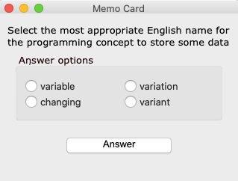
A question and the information about it
Question-related actions:
storing a question
displaying a question in an application window
reading and checking the user’s answer
displaying the correct answer
Data we need about the question:
the text of the question
the correct answer option
three incorrect answer options
Brainstorming

Slide 23
A question and the information about it
class Question():
def __init__(
self, question, right_answer,
wrong1, wrong2, wrong3):
self.question = question
self.right_answer = right_answer
self.wrong1 = wrong1
self.wrong2 = wrong2
self.wrong3 = wrong3
?
Data we need about the question:
the text of the question
the correct answer option
three incorrect answer options
Brainstorming
To ask multiple questions, we need a structure that can store a lot of data. What structure should we use?

Slide 24
A question and the information about it
class Question():
def __init__(
self, question, right_answer,
wrong1, wrong2, wrong3):
self.question = question
self.right_answer = right_answer
self.wrong1 = wrong1
self.wrong2 = wrong2
self.wrong3 = wrong3
The Question class
The class constructor, which gives the properties for an instance of Question
Properties:
– question text
– correct answer
– incorrect answer 1
– incorrect answer 2
– incorrect answer 3
Brainstorming
It’s convenient to “wrap up” the question data in the Question class.

Slide 25
Implementing the Question class
To implement Question, we must make some changes to our program.
What | Before | After
Adding a new question | Data were stored in variables | ?
Displaying a question | Widgets displayed data from variables: answers[0].setText(right_answer) | ?
Asking a question (calling ask() ) | The entry parameters were the constants with the question data | ?
Brainstorming

Slide 26
Implementing the Question class
To implement Question, we must make some changes to our program.
What | Before | After
Adding a new question | Data were stored in variables | Data are the properties of an instance of the class
Displaying a question | Widgets displayed data from variables answers[0].setText(right_answer) | Widgets display fields of the class answers[0].setText(q.right_answer)
Asking a question (calling ask() ) | The entry parameters were the constants with the question data | The entry parameter is an instance of the Question class
Brainstorming

Slide 27
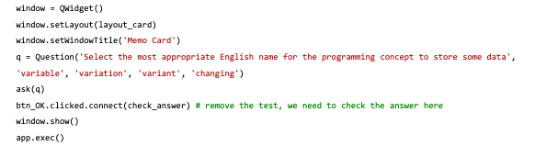
Let’s put it all together:
class Question():
Class description
Application interface
Functions that display the question
def ask(q: Question):
Brainstorming
Changed function body with the properties of instance q
Creating a window, launching the application
Creating instance q of Question
Calling ask with argument q

Slide 28
Expected results:
“Inside” the application, the data storage system shall change. Instead of storing question data in variables, we’ll have the Question class and its instances.
The application will not change externally and its functionality will not increase, but it will work differently.
Brainstorming

Slide 29

Module 2. Lesson 5. Memory Card Application. P.3
Visual Studio Code:
Memory Card Application

Slide 30




Do the task in VS Code
“VSC. PyQt. Memory Card”
Visual studio code from “Algorithmics”»
Application Creation

Slide 31
Module 2. Lesson 5. Memory Card Application. P.3
Brainstorming:
A System for Working with Questions

Slide 32
Project mind map:
Widget creation
Positioning in layouts
Global layout display
Widget creation
Positioning in layouts
Global layout display
Question form display
Answer form display
Memory Card
Question storage
Event handling
Question and answer structure
Storing all questions
Question display
Handling "Answer" button click
Handling radio button click
☑️

Slide 33
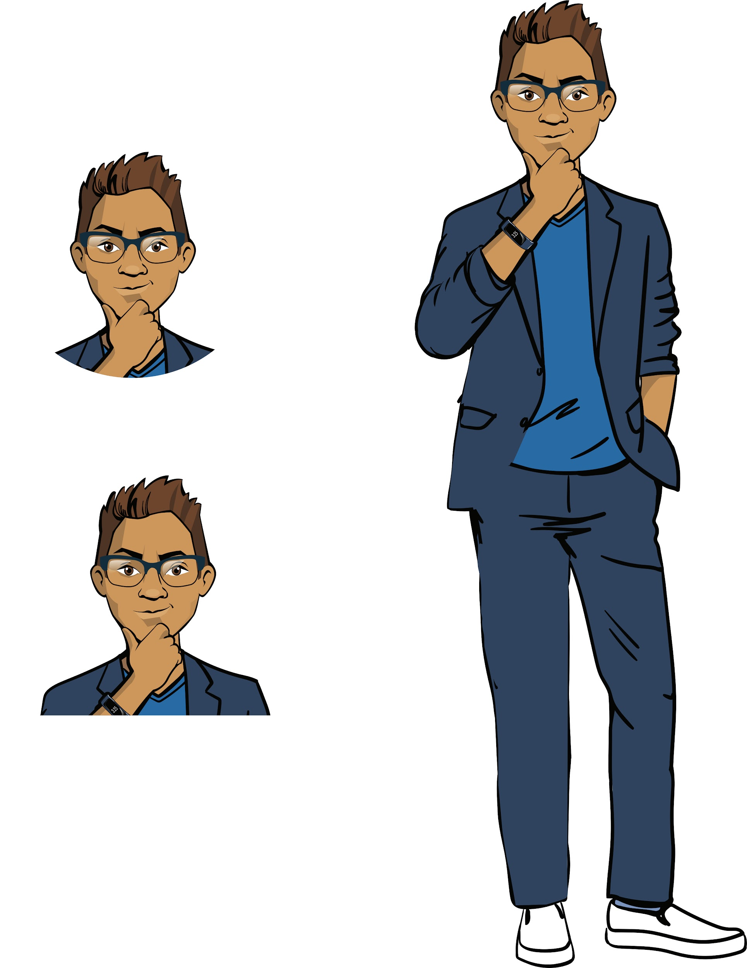
How do we work with multiple questions?
To move from one question to multiple questions, we’ll need to come up with a technical solution to the following issues:
What structure will be used to store the set of questions, and how will it be filled in?
How will the next question be displayed?
How do we switch between checking an answer
and transitioning to the next question?
Brainstorming

Slide 34
1. Storing a set of questions
One question is created as an instance of the class.
How do we create multiple instances of Question and organize their storage?
questions_list = []
q1 = Question(
'The state language of Portugal', 'Portuguese',
'English', 'Spanish', 'French')
questions_list.append(q1)
List of questions
Instance of the Question class
Adding an instance to the list of questions
Brainstorming

Slide 35
1. Storing a set of questions
One question is created as an instance of the class.
How do we create multiple instances of Question and organize their storage?
questions_list = []
q1 = Question(
'The state language of Portugal', 'Portuguese',
'English', 'Spanish', 'French')
questions_list.append(q1)
List of questions
Instance of the Question class
Adding an instance to the list of questions
Can be shortened by nesting
Brainstorming
questions_list = []
questions_list.append(
Question('The state language of Portugal',
'Portuguese', 'English', 'Spanish',
'French'))
✅

Slide 36
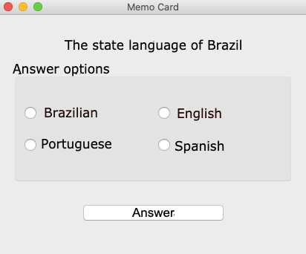
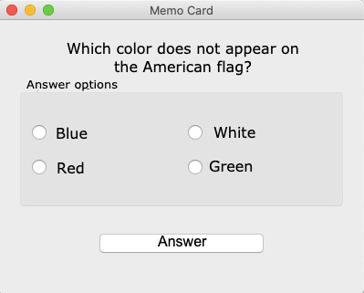
2. Displaying the next question
Let’s describe the function next_question() , which asks the next question.
To do that, we need to figure out:
How do we ask the first question? How do we check and move on to the next question?
Brainstorming

Slide 37
2. Displaying the next question
Let’s say the function next_question() has been written.
next_question()
check_answer()
Displays the next question in the list
Checks the answer to the current question (displays answer form)
Brainstorming
How do we determine which of the two functions to call at any given moment?

Slide 38
2. Displaying the next question
Let’s say the function next_question() has been written.
New function
next_question()
check_answer()
click_OK()
Displays the next question in the list
Checks the answer to the current question (displays answer form)
Calls next_question() or check_answer()
Brainstorming
Use this function to handle the button click

Slide 39
2. Displaying the next question
next_question()
check_answer()
click_OK()
Displays the next question in the list
Checks the answer to the current question (displays answer form)
Calls next_question() or check_answer()
Brainstorming
In it, choose the function to call
Use this function to handle the button click

Slide 40
2. Displaying the next question
Let’s describe the function next_question() , which asks the next question
def next_question()
To switch to the next question, we need to implement a question counter.
1
window.cur_question = -1
Brainstorming
Set a property of the window — the number of the question displayed. Give it the value -1 upon creation.

Slide 41
2. Displaying the next question
Let’s describe the function next_question() , which asks the next question.
def next_question()
To switch to the next question, we need to implement a question counter.
1
2
window.cur_question = -1
window.cur_question += 1
Brainstorming
Set a property of the window — the number of the question displayed.
Give it the value -1 upon creation.
When next_question() is called, increase the counter
by one.

Slide 42
2. Displaying the next question
Let’s describe the function next_question() , which asks the next question.
def next_question()
To switch to the next question, we need to implement a question counter.
1
2
3
window.cur_question = -1
window.cur_question += 1
If the list of questions has ended, reset the counter and start over.
Brainstorming
Set a property of the window — the number of the question displayed.
Give it the value -1 upon creation.
When next_question() is called, increase the counter
by one.

Slide 43
2. Displaying the next question
Let’s put it all together into a function:
def next_question():
When the function is called, increase the counter by 1.
If the number of the current question is equal to the length of the list, reset the counter.
Get a question from the list using a number.
Ask the question using the ask() function.
Brainstorming

Slide 44
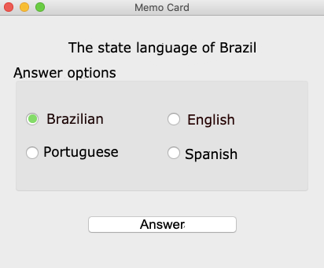
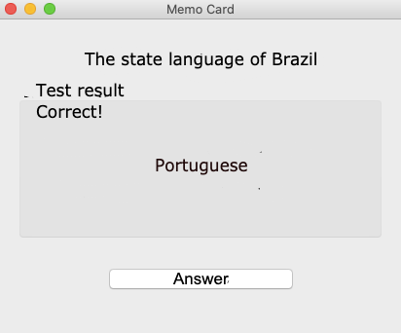
3. Checking and moving on
Let’s implement our functionality in the program:
The Question class and the set of questions
The application interface
The ask() function and accompanying elements
The check_answer() function and accompanying elements (1)
Brainstorming
The next_question() function and accompanying elements (2)
The click_ok() function, which calls (1) or (2)
Application launch, question counter = -1
Button handling by the function click_ok()

Slide 45
Expected result:
The click_ok() function regulates the processes of displaying new questions and checking answers.
The click_ok() function calls next_question() or check_answer().
Questions from the set are asked in order. If the list has ended, the first question is asked again.
Brainstorming

Slide 46
Module 2. Lesson 5. Memory Card Application. P.3
Visual Studio Code:
Memory Card Application

Slide 47
Do the task in VS Code
“VSC. PyQt. Memory Card”
Visual studio code from “Algorithmics”
Application Creation

Slide 48

Module 2. Lesson 5. Memory Card Application. P.3
Wrapping up the Work Day

Slide 49


To finish off the work day, complete this technical interview:
We need to program a new type of object and give it some properties. How do we do that?
Can we endlessly switch between different forms within the same interface? How is this issue resolved in Memory Card?
Work Day Wrap-Up
Cole,
Senior Developer
Emily,
Project Manager

Slide 50
Evaluating the effectiveness of today’s work
With your colleagues, answer the questions:
What went especially well?
What didn’t go as planned?
What can you do to ensure success next time?
Work Day Wrap-Up

Slide 51
Additional tasks
Take another look at the code you wrote.
If necessary, finish writing the code.
Add comments to the code to explain
which part of the code does what.
Work Day Wrap-Up

